Slide 1

Made by Negar . Hayat . Maral

Slide 2
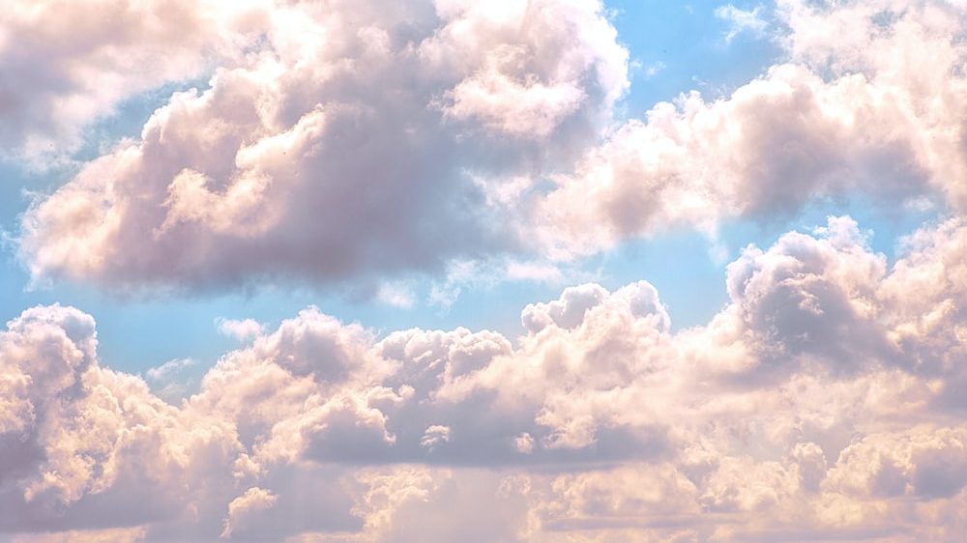
We use A/an when we're talking about :

Slide 3

1_ an example of a thing, instrument etc
(A barometer is used to measure air pressure.)
2_ one of a class of things or people
(Peter is a German .Maria is a teacher. This is an electric shaver.)
3_ one if a set of named things
(They've bought a Picasso This is a Henry more sculpture.)

Slide 4
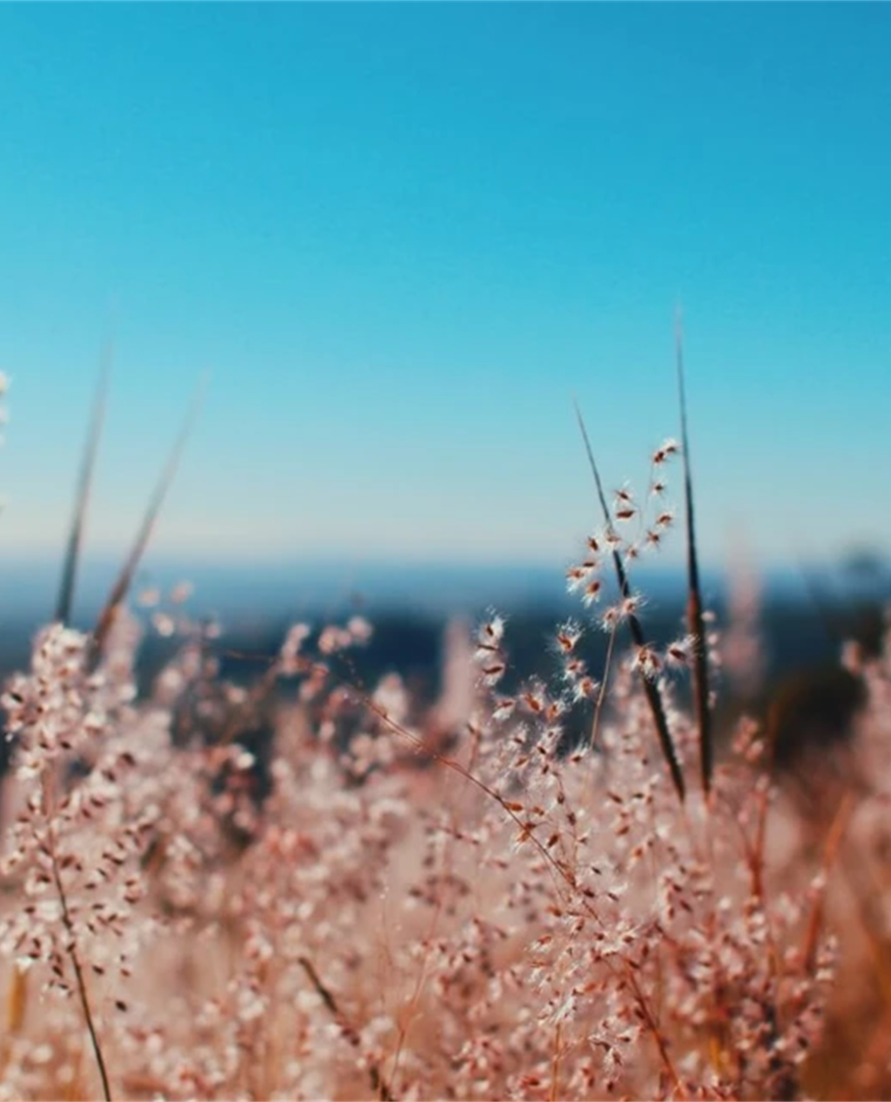
4 _ rates and speed
( The car was going at 50 km an hour.)
5 _ large whole numbers , fractions with singular nouns , weight and distances(Half is usually used without an article)
( A hundred , a million, a third ,a fifth ,two and a half , a kilo , a meter and a half)
6_ names when we mean 'a person called .....’
(is there a Tom Davis staying here?)
Tip: Half is usually used without an article

Slide 5

7_illness
(a cold , a headache etc.)
8_ exclamation
(what a fantastic slight! What an awful room)
9_ emphasis
(this is such a great film! He is such an interesting person)
Tip : But most illness words use zero article

Slide 6

We use the article when

Slide 7

1_ referring to something we already mentioned
first, I grate some cheese . Then I sprinkle the cheese into the sauce
2_ noun is made definite by the details that follow it
There's a tower over there . Yes, it's The Tower of London
3_ things are definite because they are already known to the people
Jim is at the pub( the one we usually go to

Slide 8

4_ things are made specific by the details, which follow
The water tastes funny ( The water from the tap)
The girls in my class learn fast ( these particular girls)
5 _ a singular noun to describe a class of things
The bicycle is becoming increasingly popular The whale is in danger of extinction
6_ An abstract noun is made specific by what comes after it
The health of millions of people may be at risk

Slide 9
7_ names of groups
The Democrats
8_ name of music groups
The who , primal scream , The rolling Stones , Scorpions
9_ many groups of people( The + singular adjective)
the Unemployed , the dead

Slide 10

10_ name if shops and places with a general reference
At the Cinema , the supermarket, the beach
11_ familiar objects
the sun , the moon

Slide 11
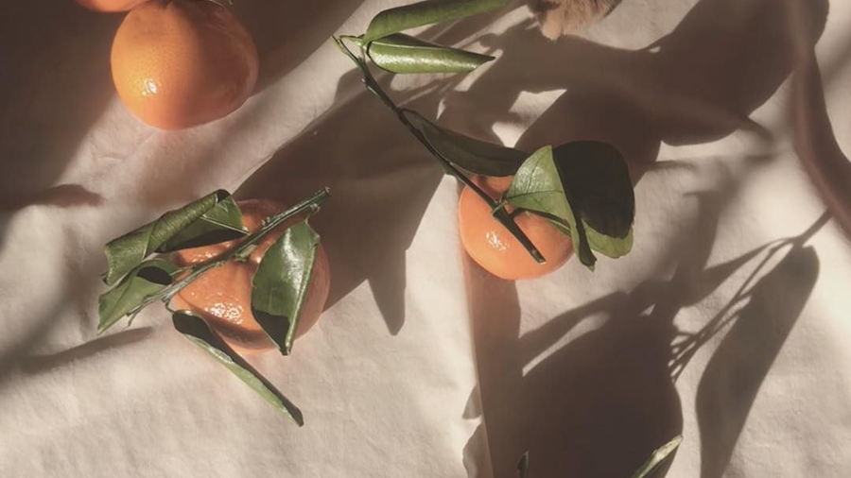
We use 0 article when we're talking about:

Slide 12

1_ plurals and uncountable when they refer to a class of things or people in general
(Teachers often work very long hours Water is becoming a scarce resource)
2_ Abstract ideas
(Health is one of the most important things in life)
3_ names of people
( Tom lives in Bristol)
( unless we specify the person)

Slide 13
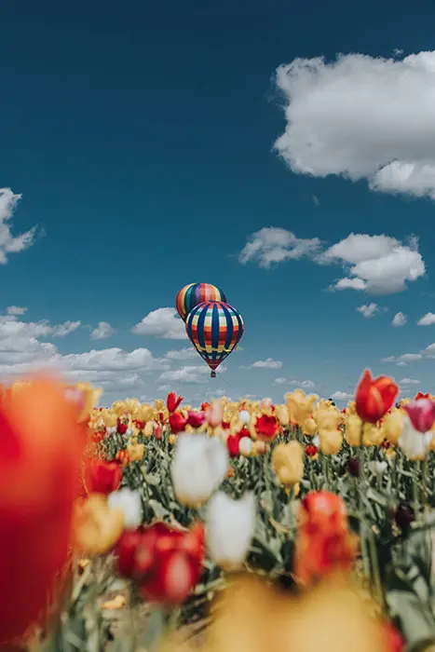
4 _ proper names
( I live in Allan Road in Bristol in an area called Redland)
(The is used when there us a post modification with of )
5_ places that their name begins of a place or person
( London Bridge , waterloo station , madame Tussaud’s)
6_if a proper name comes before the noun
( Euro MPs , Man United supporters)

Slide 14

thanks for your attention

